Slide 1
Impacts of Bioinformatics

Slide 2
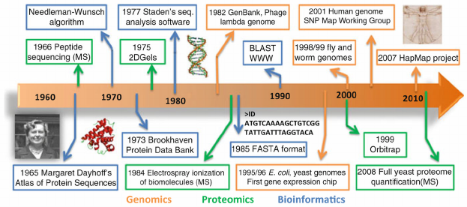
Landmarks in Bioinformatics
Source: Comparative Interaction Networks: Bridging Genotype to Phenotype
Adv Exp Med Biol. 2012 ; 751: 139–156. doi:10.1007/978-1-4614-3567-9_7

Slide 3
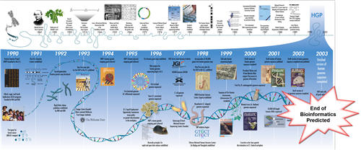
Bioinformatics here to stay?
Lincoln Stein's prediction, Feb 2003_ Bioinformatics: Gone in 2012
In 2008 he published a correction: Bioinformatics: alive and kicking
Genome Biology 2008, 9:114 (doi:10.1186/gb-2008-9-12-114)

Slide 4
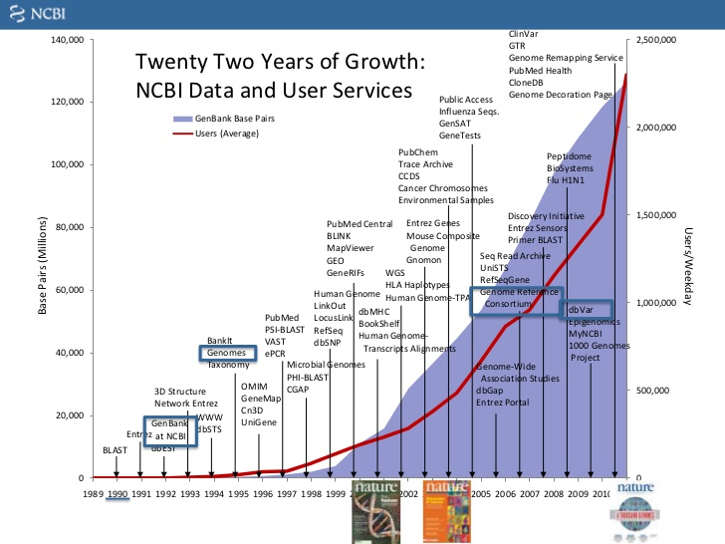
Growth of sequence data and users

Slide 5
Socially, what drives the process?
Some of the priority areas of investment that have triggered developments in Bioinformatics
1985 Biotechnology
2000 Personalised Medicine, Genomes & Health.
2010 Environmental Issues. GMOs & Food controls.
2015 Precision Medicine & Systems Biology
2020 … Immunotherapy. Ecosystem (remediation?)

Slide 6
Where is Bioinformatics heading?
Coping with the Omic information deluge and growing service needs is a big challenge in itself
But it is relatively small compared with what we anticipate will come in what concerns the need to
better interpret research data (recognise conserved domain architectures, use systems level reasoning in Biology and Medicine)
make more accurate predictions (inference)
understand complex genetic traits in health and disease

Slide 7
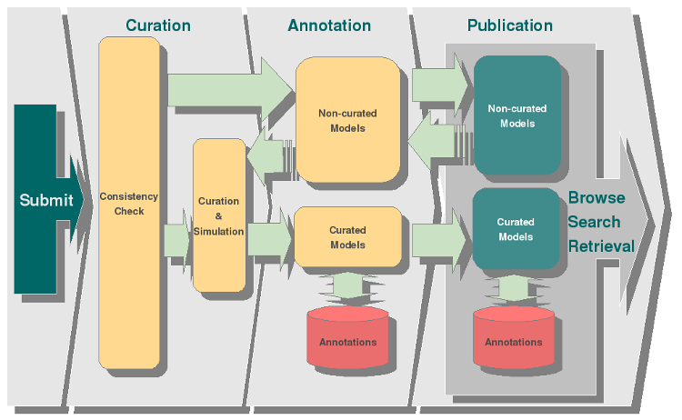
From data to curated models
Curation and annotation pipeline in the BioModels Database
Source: European Bioinformatics Institute
http://www.ebi.ac.uk/biomodels-main/develop

Slide 8
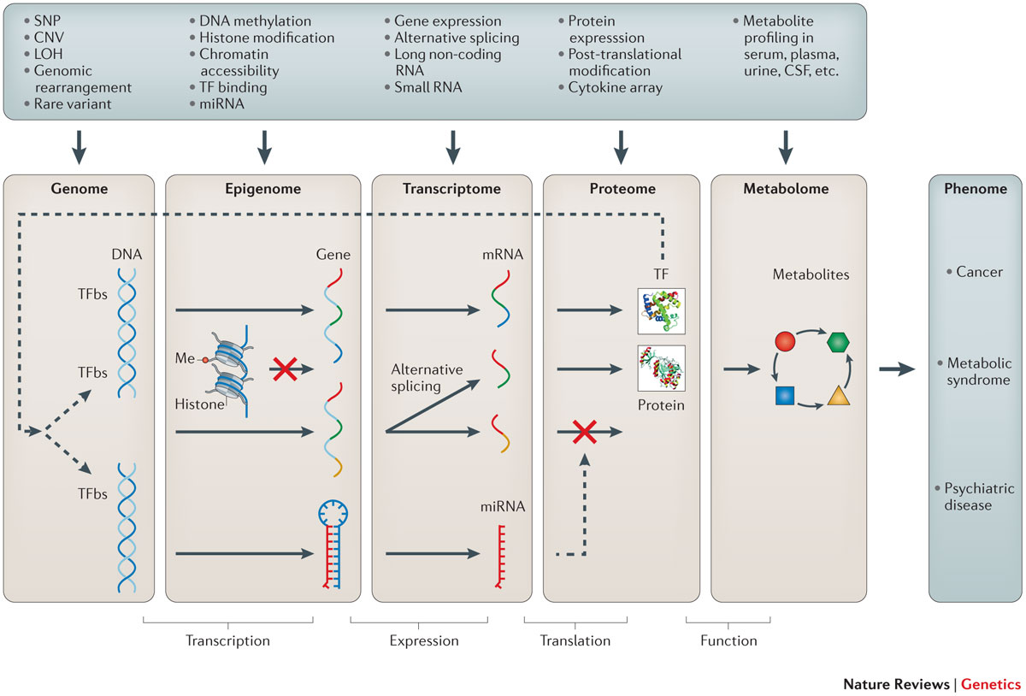
Gains in knowledge via integration
Source: Methods of integrating data to uncover genotype–phenotype interactions
Marylyn D. Ritchie, Emily R. Holzinger, Ruowang Li, Sarah A. Pendergrass & Dokyoon Kim
Nature Reviews Genetics 16, 85–97 (2015) doi:10.1038/nrg3868

Slide 9
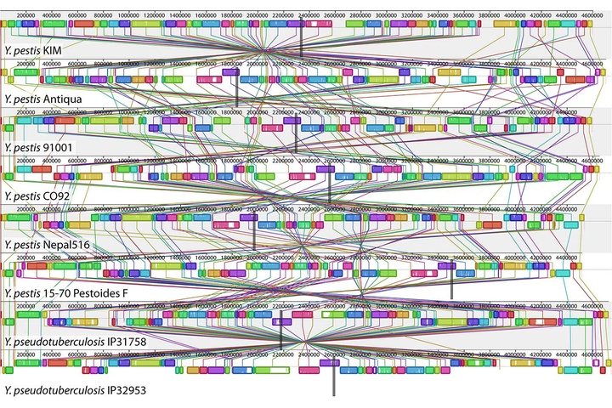
Deep understanding to fight disease
A genome alignment of eight Yersinia isolates.
(source: PLOS Genetics on Wikimedia Commons).
Deep learning meets genome biology
An interview with Brendan Frey about realizing new possibilities in genomic medicine.
https://www.oreilly.com/ideas/deep-learning-meets-genome-biology

Slide 10
Using large datasets
Using large datasets together with powerful analytics and machine learning allows for generating and testing hypotheses in unprecedented ways
It does require specific skills but the most serious bottleneck is still.. human!

Slide 11
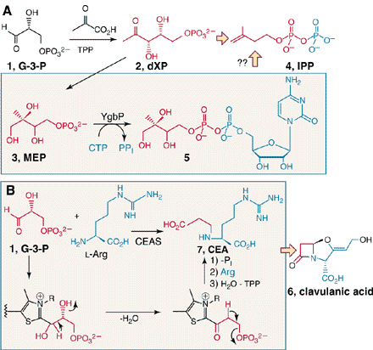
Ex.1 Arguably difficult without Bioinformatics
Science. 2000 Feb 4;287(5454):818-9.
Perspectives: biosynthetic pathways.
Biosynthesis meets bioinformatics.
Cane DE
Clavulanic Acid is a beta-Lactamase inhibitor
that helps penicicilin-like atibiotics if fighting
resistant bacteria.
YgbP was found in natural organisms by
searching sequence databases for its genomic
Signature. This led to dramatic reductions in
production costs.

Slide 12
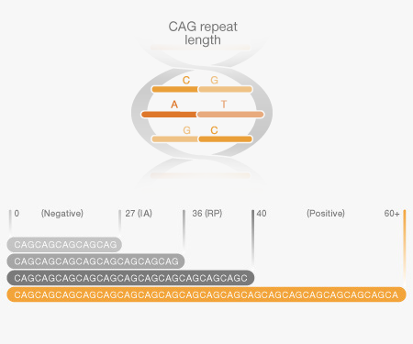
Ex.2 Arguably difficult without Bioinformatics
The number of CAG repeats in the HD (Huntington Disease) gene on Chr4, discovered in 1993, determines disease severity.
This relationship was drawn by classifying sequencing reads in large quantities and comparing clinical observations in a large scale.
This has allowed for designing genetic tests that are useful in family genetic counselling, to reduce the chances of anticipation, as the repeats go longer in successive generations.

Slide 13
The human resource issues
Education
The need for Bioinformatics-aware biomedical professionals is horizontal. All Life Science related professionals need to know at least the basics.
Training
Bioinformatics tools and data resources evolve rapidly and their correct usage requires skills. We need trained people that can use their skills autonomously.

Slide 14
Motivation to carry-on
This is why teaching introductory Bioinformatics in a large scale becomes so important.
Should motivate you to deepen your knowledge in this course and acquire specific skills by attending training sessions.
It did motivate all of us to collaborate in bringing the IBT course to life!

